Slide 1
Basic Electrical and Electronics Engineering
Unit 5 LECTURE 2
Dr. Sonam Shrivastava/ Assistant Professor (Sr.) /SELECT

Slide 2
Applications
Rectifier
A rectifier is an electrical device that converts alternating current (AC), which periodically reverses direction, to direct current (DC), which is in only one direction, a process known as rectification.

Slide 3
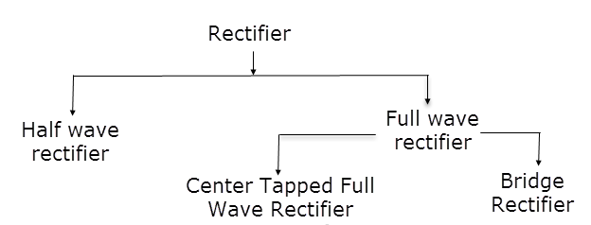
Types of Rectifiers

Slide 4
Half wave rectifier
In half wave rectification, either the positive or negative half of the AC wave is passed, while the other half is blocked.
Because only one half of the input waveform reaches the output, it is very inefficient if used for power transfer.

Slide 5
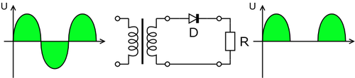
Half wave rectifier

Slide 6
Full wave rectifier
A full-wave rectifier converts the whole of the input waveform to one of constant polarity (positive or negative) at its output.
Full-wave rectification converts both polarities of the input waveform to DC (direct current), and is more efficient.
One is center tapped full wave rectifier consisting of two diodes and one center tapped secondary winding transformer and the second is a Bridge Rectifier consisting of four diodes.

Slide 7
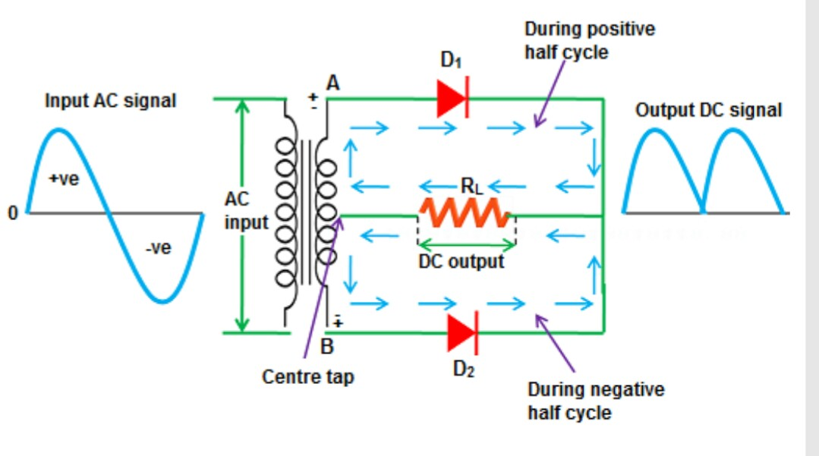
Full wave rectifier

Slide 8
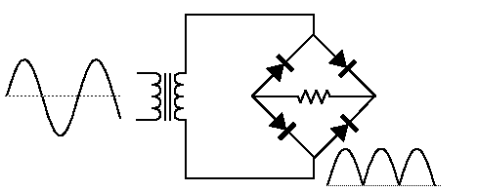
Bridge rectifier
A bridge rectifier makes use of four diodes in a bridge arrangement to achieve full-wave rectification.

Slide 9
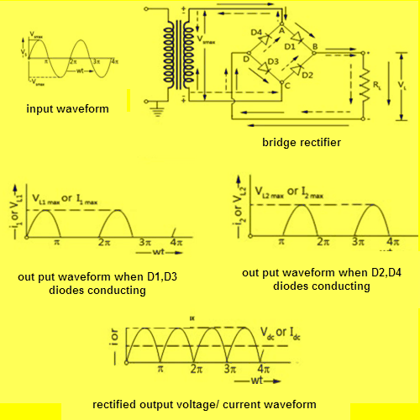
Bridge rectifier

Slide 10
Bridge rectifier

Slide 11
Bridge rectifier

Slide 12
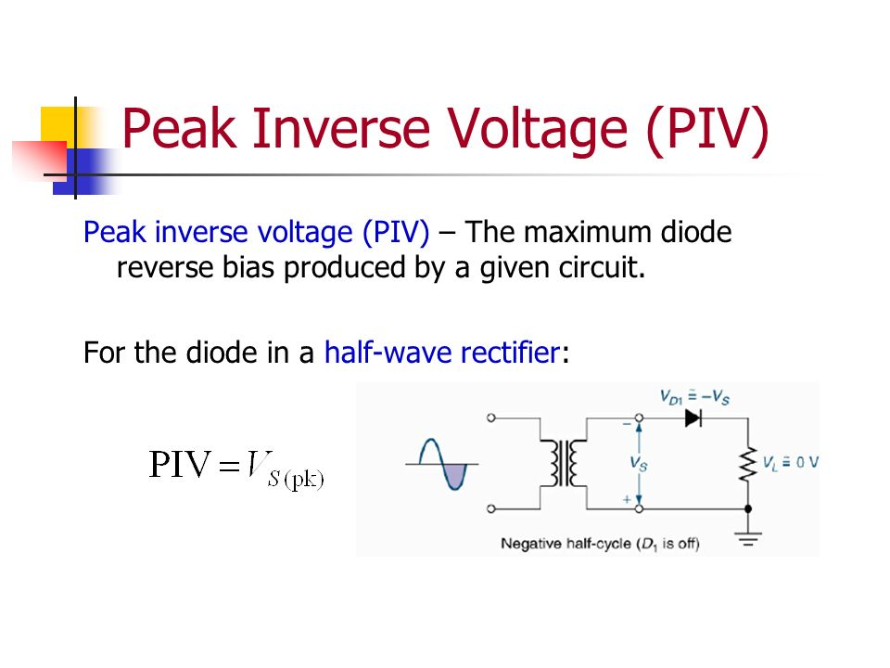

Slide 13
PIV for center tap rectifier
Peak inverse voltage (PIV) is the maximum possible voltage across a diode when it is reversed-biased.
During first half-cycle of the supply i.e. when the top of the transformer secondary winding is positive, diode D1 conducts and offers almost zero resistance.
So whole of the voltage Vp of the upper half winding is developed across the load resistance RL.
Now voltage across the non-conducting diode D2 is the sum of voltage across the lower half of the transformer secondary and the voltage across the load resistance RL.
Thus PIV of diode, D2 = Vm + Vp = 2 Vp
Similarly, PIV of diode D1 = 2 Vp

Slide 14
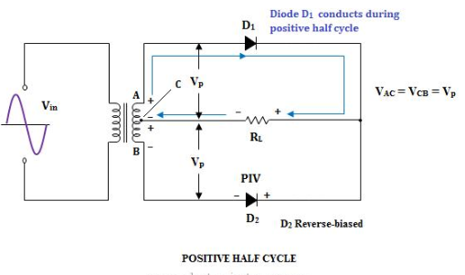
PIV for center tap rectifier

Slide 15
PIV for bridge rectifier
When the secondary voltage gets its peak positive value and the terminal A is positive, and B is negative. So at this instant, the diode D1 and D3 are forward biased.
D2 and D4 are in reverse bias they won’t conduct, but only the diodes D1 &D3 will conduct current through them. Therefore, in between the terminal M-L or A’-B’ gets the same voltage as that the terminals A-B.
PIV of diode D1 and D3 = Vm
Similarly PIV of diode D2 and D4 = Vm

Slide 16
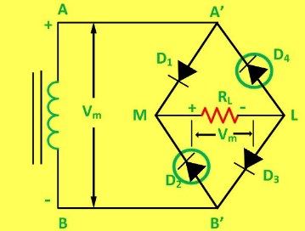
PIV for bridge rectifier

Slide 17
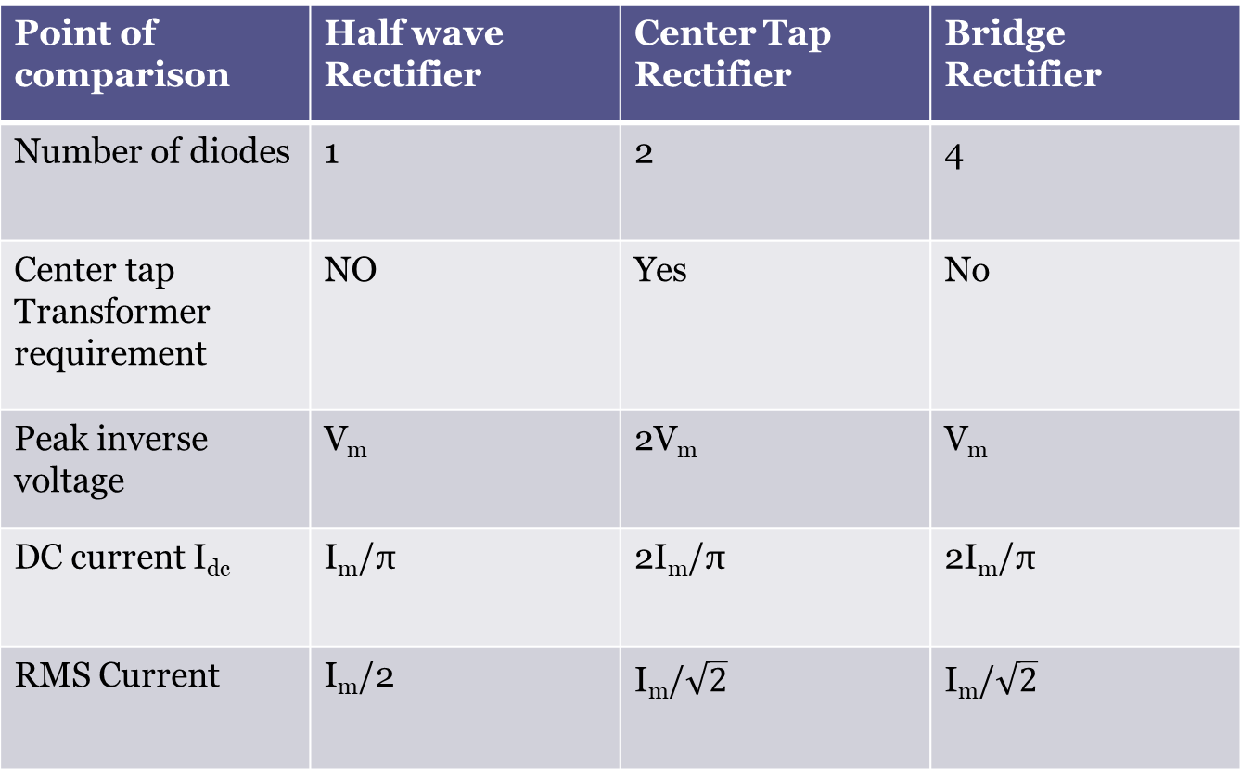
Point of comparison | Half wave Rectifier | Center Tap Rectifier | Bridge Rectifier
Number of diodes | 1 | 2 | 4
Center tap Transformer requirement | NO | Yes | No
Peak inverse voltage | V_{m} | 2V_{m} | V_{m}
DC current I_{dc} | I_{m}/π | 2I_{m}/π | 2I_{m}/π
RMS Current | I_{m}/2 | I_{m}/$\sqrt{2}$ | I_{m}/$\sqrt{2}$

Slide 18
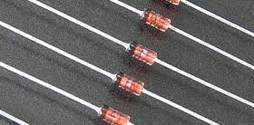
Zener diode
When reverse voltage reaches breakdown voltage in a PN diode, the current through the junction and power dissipated at the junction will be high.
Such an operation is destructive and the diode gets damaged.
However, diodes can be designed with adequate power dissipation capability to operate in the breakdown region.
One such diode is Zener diode which is heavily doped than the ordinary diode.

Slide 19
Zener diode
A Zener diode is a silicon PN junction semiconductor device which is operated in its reverse breakdown region.
Zener diodes are available having Zener potentials of 1.8 to 200 V with power ratings from 0.25W to 50 W.
Because of its higher temperature and current capability, silicon is usually preferred in the manufacture of Zener diodes.

Slide 20
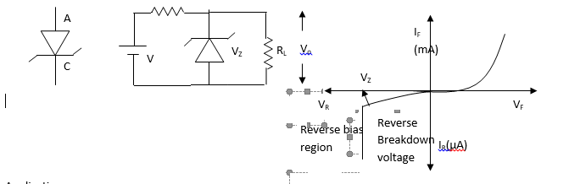
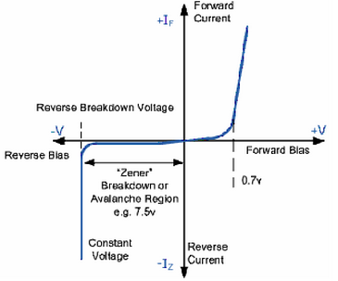

Slide 21
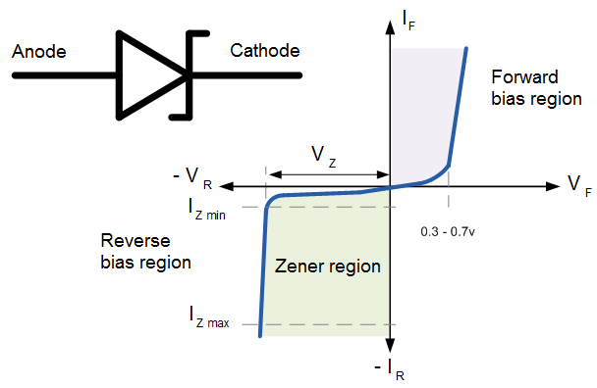

Slide 22
The forward bias condition is same as the ordinary PN diode, but Under reverse bias condition, breakdown of the junction occurs and the breakdown voltage depends upon the amount of doping.
If the diode is heavily doped, depletion layer will be thin and consequently breakdown occurs at lower reverse voltage, besides the breakdown voltage being sharp.
Thus the breakdown voltage can be selected with the amount of doping. When the reverse bias field across the junction is sufficiently high, it may exert a strong force on bound electrons to tear them out from a covalent bond.
Thus a large number of electron – hole pairs will be generated through a direct rupture of the covalent bond thereby resulting in large reverse current at the breakdown voltage.
Though Zener breakdown occurs for lower breakdown voltage and avalanche breakdown occurs for higher breakdown voltage, such diodes are normally called Zener diode

Slide 23
Application
From the zener diode characteristics, under the reverse bias condition, the voltage across the diode remains almost constant although the current through the diode increases.
Thus the voltage across the zener diode serves as a reference voltage. Hence the diode can be used as a voltage regulator.

Slide 24
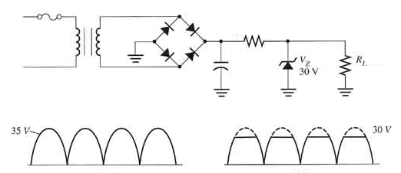
Zener Diode Voltage regulation:
Line regulation
Load Regulation

Slide 25
The arrangement shown is useful when it is required to provide a constant voltage across a load resistance R_{L} where as the input voltage may be varying over a range.
As shown, the zener diode is reverse biased and as long as the input voltage does not fall below Vz, the voltage across the diode will be constant and hence the load voltage will also be constant.

Slide 28
S. No. | Topic | Link
1 | PN Junction diode | https://www.youtube.com/watch?v=btOIDQeMrMg&t=199s
2 | Zener Diode | https://www.youtube.com/watch?v=V5nWu8EbMhI&t=33s
3 | BJT | https://www.youtube.com/watch?v=fIvZen2tq_w
4 | Rectifier | https://www.youtube.com/watch?v=quyqtaKIr78
5 | MOSFET | https://www.youtube.com/watch?v=Bfvyj88Hs_o

Slide 29
Thank you

